Slide 1
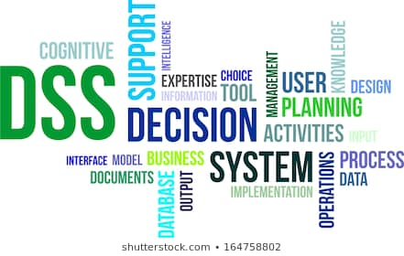
Decision Support Systems
Decision Support Systems Concepts, Methodologies, and Technologies:
An Overview
Lecture 6

Slide 2
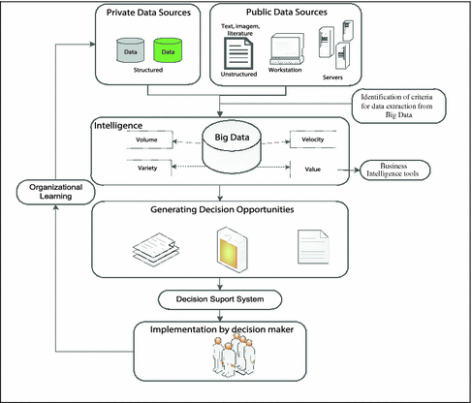
Integrated Model for Decision-Making Process,
Big Data, and BI Tools

Slide 3
The main contributions of the previous model are
Develop a perspective that combines the decision-making process, Big Data, BI, DSS, and organizational learning.
Use the concept that Big Data works as a data provider over which may be applied BI techniques and tools may be applied mainly in supporting the discovery of alternatives for a decision.
BI Techniques: Predictive Modeling - Characterization and descriptive data mining
BI Tools: Domo BI – Dundas BI - IBM Cognos Analytics – Style Intelligence

Slide 4
Forms of Data Analytics:
Descriptive Analytics tells you what happened in the past.
Diagnostic Analytics helps you understand why something happened in the past.
Predictive Analytics predicts what is most likely to happen in the future.
Prescriptive Analytics recommends actions you can take to affect those outcomes.

Slide 5
DSS Description
DSS is an approach (or methodology) for supporting decision making
uses an interactive, flexible, adaptable Computer-based Information System (CBIS)
developed (by end user) for supporting the solution to a specific unstructured management problem
uses data, model and knowledge along with a friendly (often graphical; Web-based) user interface
incorporate the decision maker's own insights
supports all phases of decision making
can be used by a single user or by many people

Slide 6
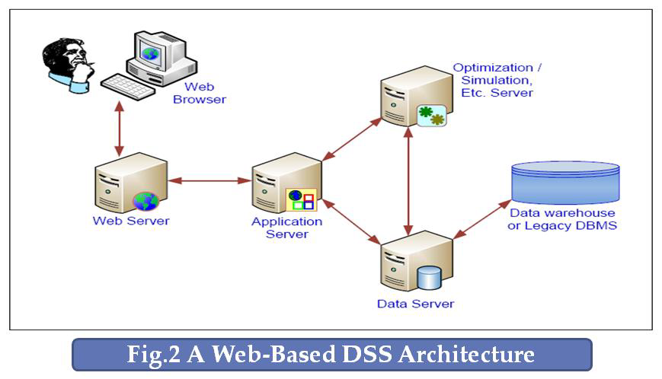
A Web-Based DSS Architecture
Web-based should mean the entire application is implemented using Web technologies (Web server, HTML, CGI, and possibly database products like Oracle or SQL server.

Slide 7
A Web-Based DSS Architecture
Common Gateway Interface is an interface specification that enables web servers to execute an external program, typically to process user requests
CGI is a standard for interfacing external applications with information servers, such as HTTP or Web servers.
CGI, permits interactivity between a client and a host operating system through the World Wide Web via the Hyper Text Transfer Protocol (HTTP).

Slide 8
DSS Characteristics and Capabilities

Slide 9
DSS Classifications
There are 3 types: Passive, active, and cooperative DSS.
A passive DSS is a system that aids the process of decision making, but that cannot bring out explicit decision suggestions or solutions.
An active DSS can bring out such decision suggestions or solutions
A cooperative DSS allows the decision maker (or its advisor) to modify, complete, or refine the decision suggestions provided by the system, before sending them back to the system for validation. The system again improves, completes, and refines the suggestions of the decision maker and sends them back to the decision maker for validation

Slide 10
Other DSS Categories
Institutional and ad-hoc DSS
Institutional :Problems of recurring nature
Ad hoc :Problems that are not anticipated or are not repetitive

Slide 11
Other DSS Categories
Individual support system versus group support system (GSS)
A workgroup often works on separate problems within its area of responsibility.
In group work, multiple people cooperate to solve the same problem.
Insurance claims processing could be group work if handling a claim required the cooperation of policy analysts, medical experts, vehicle dynamics experts, legal experts, and others.

Slide 12
Alter's Output Classification
Data Orientation
1. File drawer systems that provide access to data items.
Usage pattern: Simple inquiries
Example:
ATM Machine: Discover the account balance before deciding how much to withdraw
2. Data analysis systems that support the manipulation of data by computerized tools tailored to a specific task and setting or by more general tools and operators.
Usage pattern: Manipulation and display of data.
Example:
Airline Reservation system

Slide 13
Alter's Output Classification
Data and Models Orientation
3. Analysis information systems that provide access to a series of decision-oriented database and small models.
Usage pattern: Programming special reports and developing small models.
Example:
Compare growth in revenues to industry average (Requires access to many sources)

Slide 14
Alter's Output Classification
Models Orientation
4. Accounting and financial models that calculate the consequences of possible actions.
Usage pattern: Input estimates of activity; estimated monetary result as output. Cannot handle uncertainty
Example:
Calculate production cost
Make pricing decisions
5. Representational models that estimate the consequences of actions on the basis of simulation models.
Usage pattern: Input possible decision; receive estimated results as output. Can incorporate uncertainty.
Example:
1) Uses models to solve decision problem using forecasts
2) Use the demand data to forecast next years demand

Slide 15
Alter's Output Classification
Models Orientation
6. Optimization models that provide guidelines for action by generating an optimal solution consistent with a series of constraints.
Usage pattern: Input constraints and objectives; receive answer. Can incorporate uncertainty
Example:
Provide the best assignment schedule
7. Suggestion models that perform the logical processing leading to a specific suggested decision for a fairly structured or well- understood task.
Usage pattern: Input a structured description of the decision situation; receive a suggested decision as output. May incorporate an Expert System
Example:
use the system to recommend a decision

Slide 16
Alter's Output Classification

